Slide 1
PCP1202 - UNIT 5
WEB APPLICATION USING ADVANCED DJANGO

Slide 2
Advanced Django Programming- Customizing the Admin
Presented by,
Subalakshmi Shanthosi S

Slide 3
Session Metadata
Author | Subalakshmi Shanthosi S
Reviewer | Dr. R S Milton (Yet to be reviewed)
Version Number | 1.2
Release Date | 21 May 2019

Slide 4
Revision History
Revision Date | Details | Version no.
19 May 2019 | Admin application changes | 1.1
21 May 2019 | 2. New SSN Template added | 1.2

Slide 5
Session Objectives
To understand how to setup “Automatic admin Application”.
Learn customisation using ModelAdmin sub classes.
Working with custom options :
list_display
list_filter,
search_fields
Changing Layout and Style Using Fieldset.
Extending the Base Templates.

Slide 6
Changing Layout and Style Using Fieldset
Fieldsets- granularity of how the data is displayed.
Example : Adding CSS and grouping fields .
class Person(models.Model):
firstname = models.CharField(max_length=50)
lastname = models.CharField(max_length=50)
city = models.CharField(max_length=50)
state = models.CharField(max_length=2)

Slide 7
Changing Layout and Style Using Fieldset
class PersonAdmin(admin.ModelAdmin):
fieldsets = [
(“Name”, {“fields”: (“firstname”, “lastname”)}),
(“Location”, {“fields”: (“city”, “state”)})
]
admin.site.register(Person, PersonAdmin)
Fieldset - list of two tuples : First : Group of fields , Second : Dictionary

Slide 8
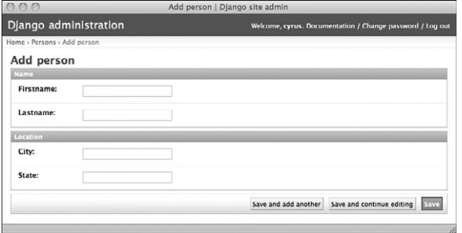
Options in FieldSet contd...
Three options :
Classes: CSS Field properties
Description: help_text description about the field group
Fields: Dictionary - two tuple

Slide 9
Extending the Base Templates
{% extends “admin/base.html” %}
{% load i18n %}
{% block title %}{{ title|escape }}|{% trans ‘Django site admin’ %}{% endblock %}
{% block branding %}
<h1 id=”site-name”>{% trans ‘Django administration’ %}</h1>
{% endblock %}
{% block nav-global %}{% endblock %}
Make sure in INSTALLED_APPS - settings.py - the app name should be registered before django.contrib.admin

Slide 10
Adding New Views
Requirements for adding custom view for admin page:
Your view should ideally be mapped to a URL that is “inside” the admin app’s URL space.
Your view should look like the rest of the admin; in other words, it should render its responses using the admin site template.
Your view should use Django’s authentication decorators.

Slide 11
Authentication Decorators
Decorators are functions that change other functions.Your Django views are functions.You want to change them in a specific way—to restrict access so that only certain users can call them—and this is a natural fit for decorators.
In simple words - Decorators are guard to view functions.
For enforcing authentication,a single decorator does most of the heavy lifting for you, called user_passes_test.
In settings.py - LOGIN_URL : /accounts/login/?next=/jobs/101/
user_is_staff : returns true or false for a user object.
Lambda - anonymous ad-hoc function
U.is_staff - create/update/delete privileges.
U.can_create_secretmeeting - can create secret meetings.

Slide 12
Example For Auth Decorator
def user_is_staff(user):
return user.is_staff
@user_passes_test(user_is_staff)
def for_staff_eyes_only(request):
print “Next secret staff meeting date: November 14th”
@user_passes_test(lambda u: u.is_staff)
def for_staff_eyes_only(request):
....
@user_passes_test(lambda u: u.can_create_secretmeeting)
def secret_meeting_create(request):

